Slide 1

Phase III: Implementation
DATA VISUALISATION PROJECT:
CREATING APP ANALYSIS DASHBOARD
FOR GOOGLE PLAY STORE DATASET
Presented by: Shrina Patel
Chandana Kandari

Slide 2
Explanation: The Dataset
The data from the Play Store apps has tremendous potential to drive successful app-making businesses. The developers will draw actionable insights to work on and win the Android market! The data from the Play Store applications has enormous potential to push successful app-making businesses.
The developers will draw actionable lessons to work on and win the Android market. The dataset is extracted from Kaggle. It's 10k Play Store apps site scraped data for evaluating the Android market.
The google play store dataset consists of 10841 rows and 13 columns. The target variable is “Installs” (number of installation), and explanatory variables include category, price, ratings, and reviews, etc.
Specifically, ‘Rating’ is a continuous variable with a scale of 1–5. Family and Game apps have the highest market prevalence. Interestingly, Tools, Business and Medical apps are also catching up.

Slide 3
Data Preparation & Pre-Processing
Data Cleaning done before loading the dataset into the tableau:
Removed '+' from 'Number of Installs' to make it numeric
One of the Rows had mismatch data entries, so shifted the cells towards right to match the data entries.
In the ‘Rating’ attribute, replaced NaN Values to -1 to make it Numeric instead of String.
After successful preprocessing of dataset, data is finally prepared for visualization.

Slide 4
Dashboard Users
Dashboard will be developed for Application developers and Mobile Application Users.
Application developers can use this dashboard for visualizing the information that make them understand the users’ preferences like:
The Applications that have the highest Installs, Rating, Reviews in a particular Category or among Categories
The type(free/paid) of application of a particular category affect Rating.
Price affect the average rating of applications.
Number of Distinct Applications over Content Rating across the selected Category.
Comparison of number of paid and free applications across categories
Number of people reviewed each app, as percent of number of installations.
Mobile Application Users can use this dashboard for visualizing the information that help them in analyzing and comparing the applications of same category that serve the intended function:
The applications that has the highest installs, Reviews, Rating in a particular Category or among Categories.
Distinct Applications over Content Rating across the selected Category.
Number of people reviewed each app, as percent of number of installations.
Price affect the average rating of applications.

Slide 5
Questions: The list of questions that the dashboard will answer.
Visualization of Number of people reviewed each app, as percent of number of installations? (percentage of reviews over the number of Installations for a selected application)
Visualization of Top N Applications from the user selected Categories based on Ratings, Reviews, and Installs as per the users’ choice.
Visualization of Distinct Applications over Content Rating across the selected Category.
Visualization of Average Rating for a selected Priced Application(How do price affect average rating?)
Extra Plots:
How do the type(free/paid) of application of a particular category affect Rating?
Comparison of number of paid and free applications across categories?

Slide 6
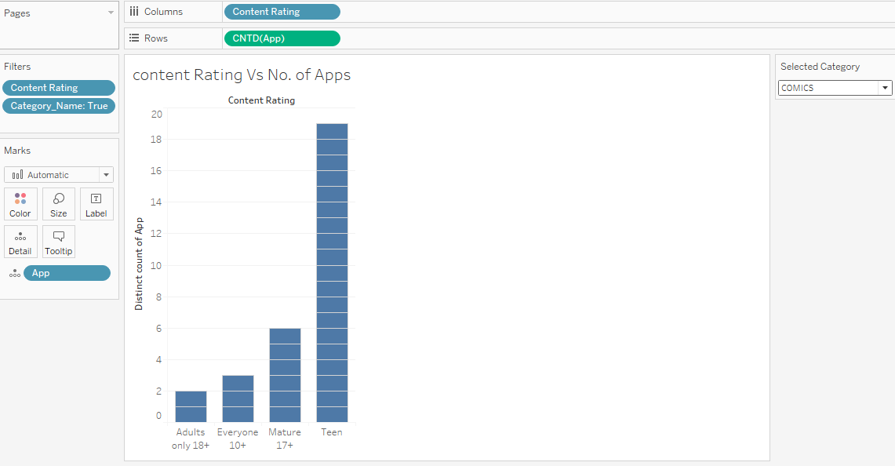
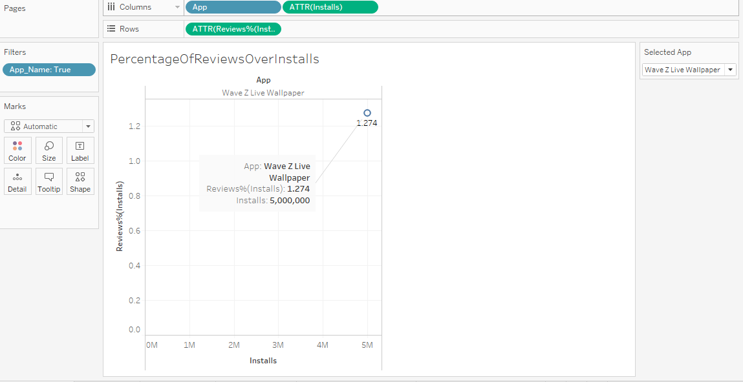
Plots
Visualization of Distinct Applications over Content Rating across the selected Category.
Percentage of reviews over the number of Installations for a selected application
Scatter plot is used for this type of visualization where the bar is apps and ATTR (installs) and the value is Reviews%(Installs)
List of Pre-attentive attributes: Form – 2D position, Spatial grouping, Form- Shapes
Bar chart is used for visualization.
List of pre-attentive attributes- Form- line length, line width, color (Intensity, Hue), Enclosure and Orientation.

Slide 7
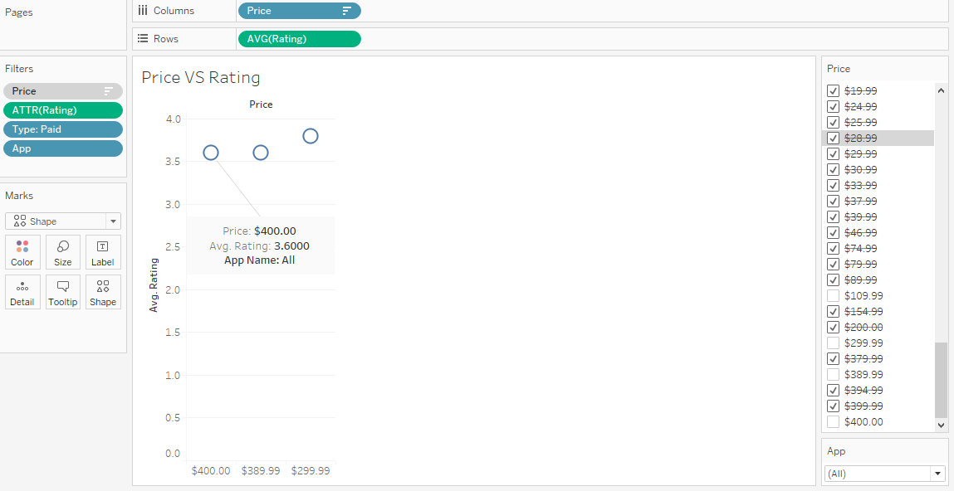
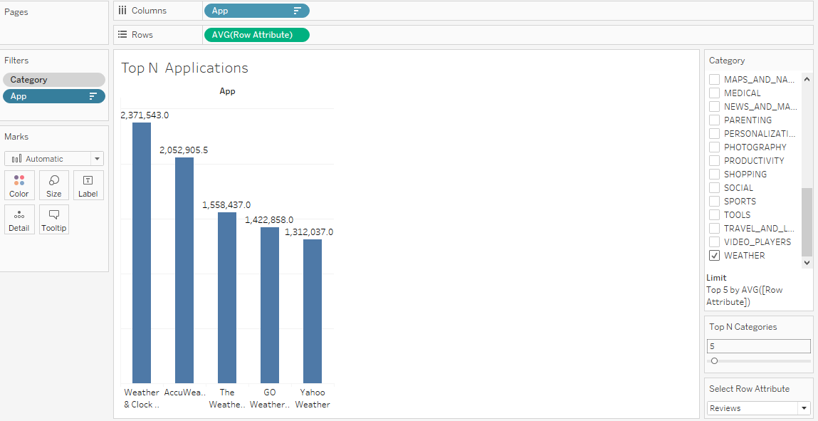
Visualization of Average Rating for a selected Priced Application(How do price affect average rating
Visualization of Top N Applications from the user selected Categories based on Ratings, Reviews, and Installs as per the users’ choice.
Bar chart is used to visualize the data where the bar is application and the values are taken as average number of Reviews/Ratings/Installs as per the user choice and sorted in descending order.
It determines the list of application that has highest average number of Reviews/Ratings/Installs as per the user choice.
List of pre-attentive attributes- Form- line length, line width, color (Intensity, Hue), Enclosure and Orientation.
Scatter plot is used for doing the visualization where the bar is price ( a multiple values list with excluded values) and the value is taken as average rating.
Average Rating for all Applications over a selected prices.
List of Pre-attentive attributes: Form – 2D position, Spatial grouping, Form- Shapes

Slide 8
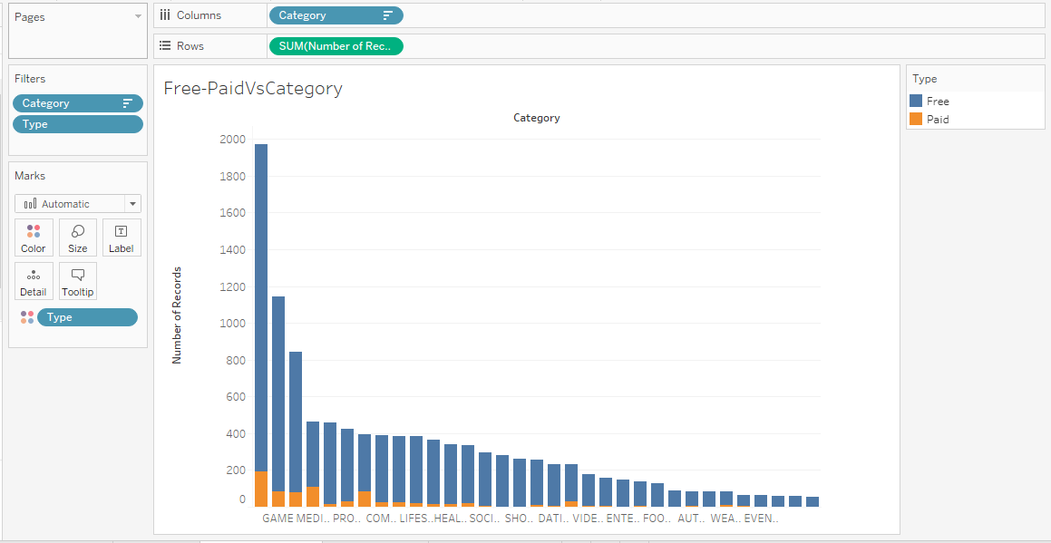
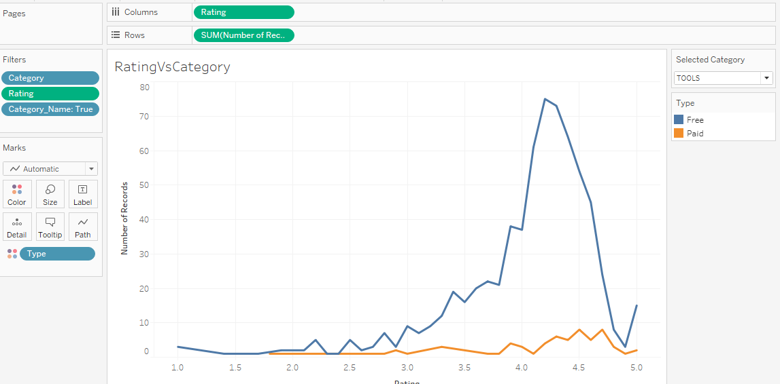
What is the rating across the categories based on types
Comparison of number of paid and free applications across categories?
Stacked bar chart is used for visualization where bar is Category and value is taken as Number of records. Stacked bar charts are extremely useful as we want to visualize and compare category wise data in one visualization.
List of Pre-attentive attributes: Form- line length, line width, color (Intensity, Hue), Enclosure and Orientation.
Line chart is used to visualize the data where the bar is rating, and the values is taken as number of records. This graph visualizes based on the created calculated field and parameter control we can select category for which we want to visualize rating that are differentiated based on types(Free/ paid apps).
List of Pre-attentive attributes: Form – curvature, added marks, shows changing over time- trend, Spatial position, color (for visualizing difference between types).

Slide 9
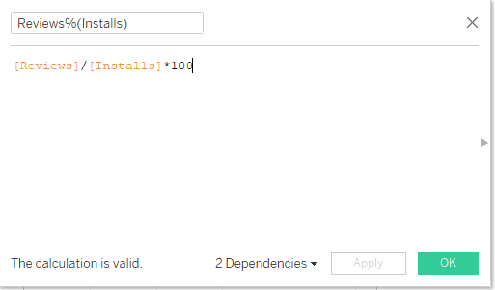
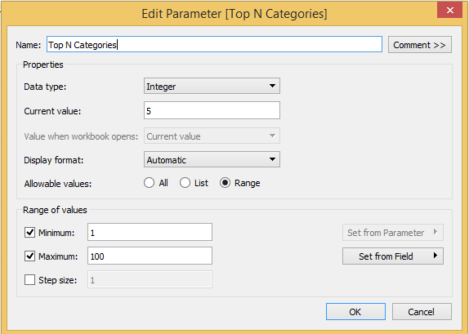
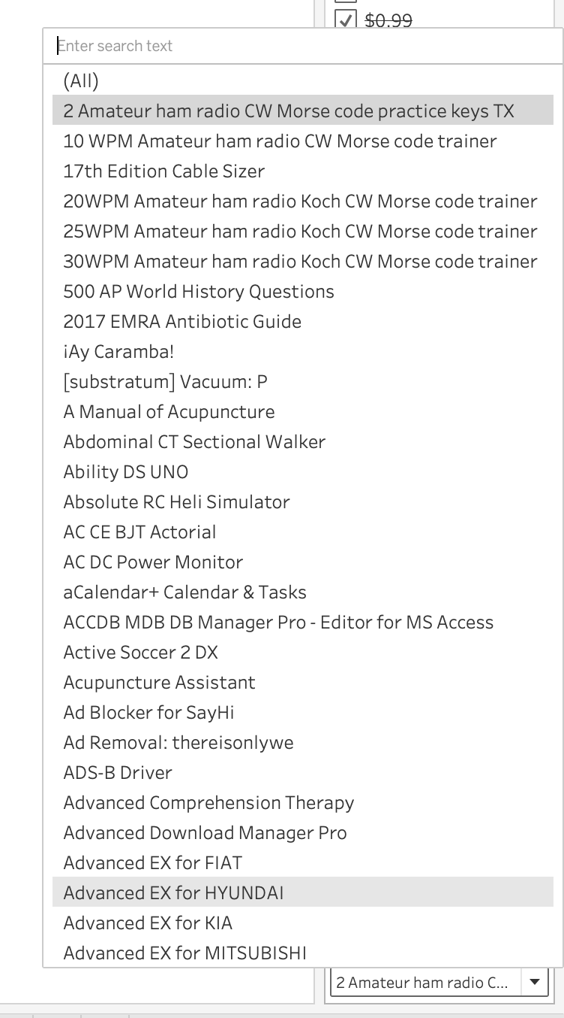
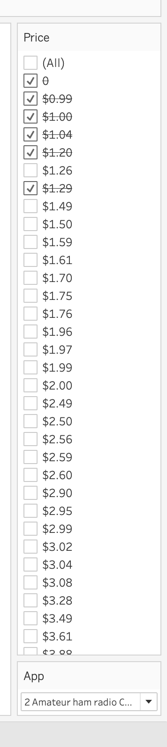
Interactivity
Calculated field- Reviews % (Installs)- Used for Visualization of Number of people reviewed each app, as percent of number of installations
Sliding bar as a parameter control is created as the user can select based on their interest how many applications average number of Reviews/Ratings/Installs they want to visualize.
Create parameter control for Top N categories by field.
How to price affect rating- Drop down menu parameter control for apps and checklist for Price.

Slide 10
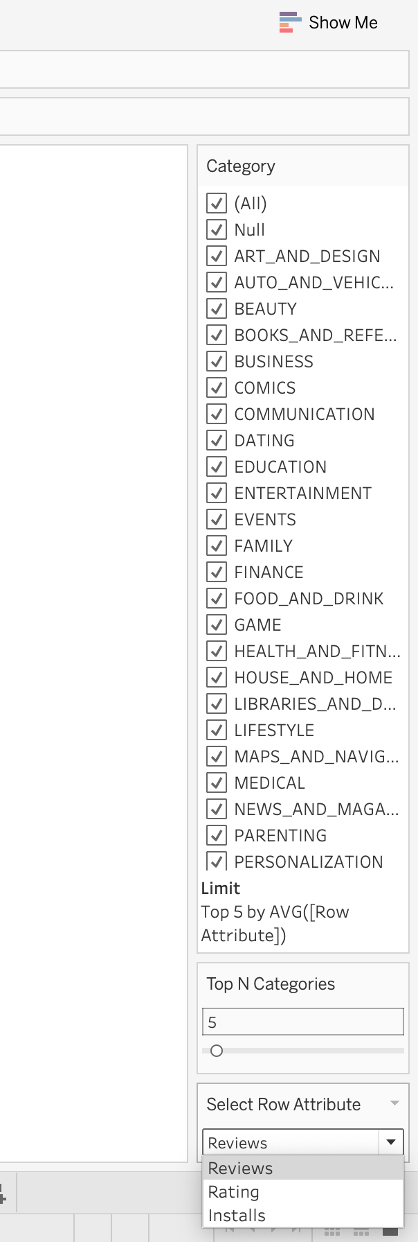
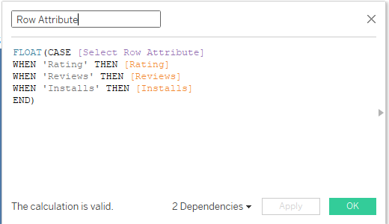
Visualization of Top N Applications from the user selected Categories based on Ratings, Reviews, and Installs as per the users’ choice.
Checklist created for selecting category for visualization and slider bar for Top N Categories.
Multiple value list for selecting the category based on which the app are displayed for a selected row attribute i.e.. Visualization based on Reviews, Rating and Installs
Select Row Attribute’ Parameter – Drop down menu

Slide 11
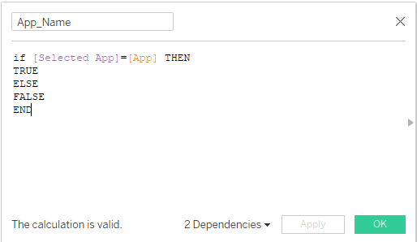
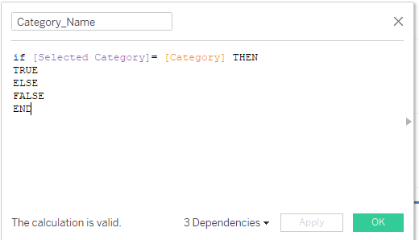
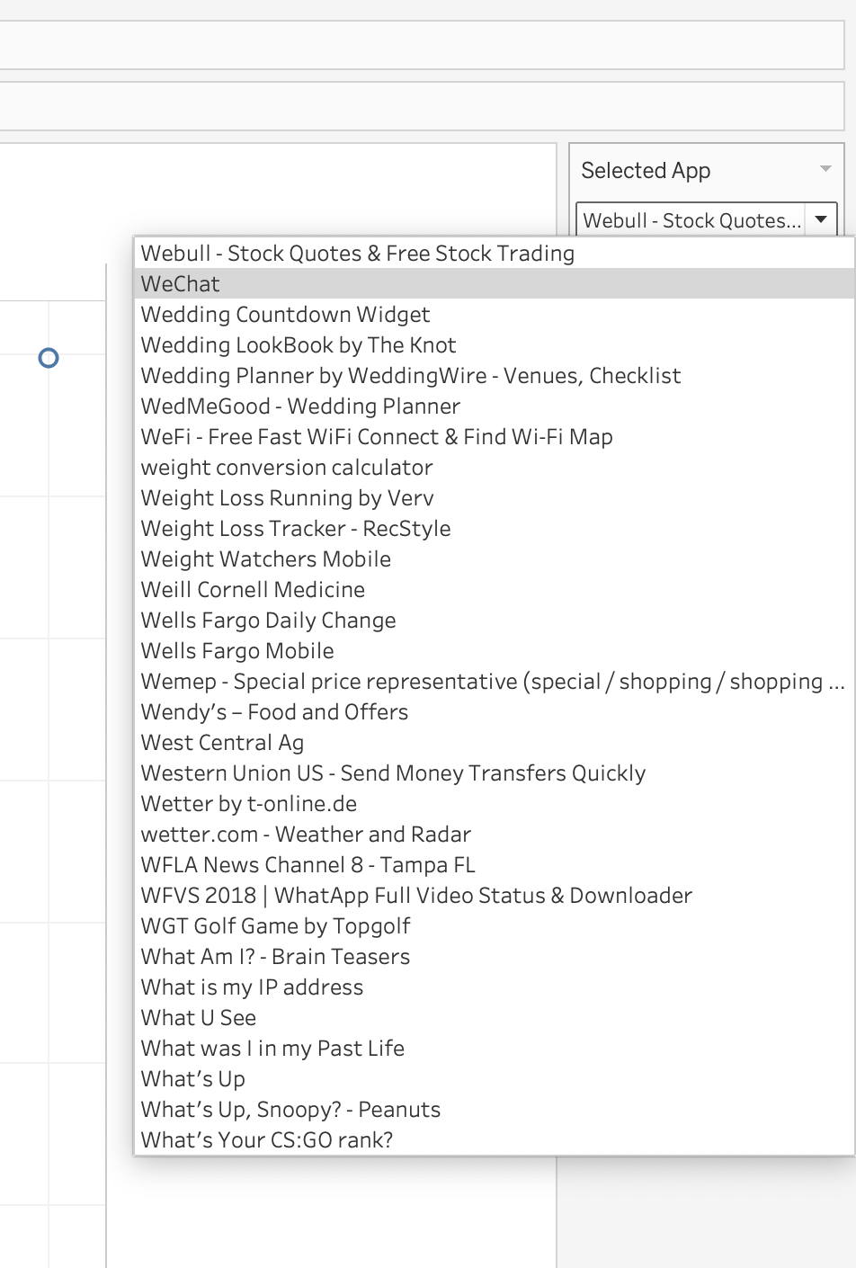
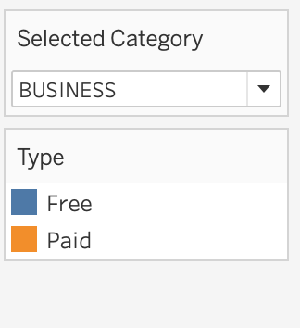
App_Name – Used for Visualization of Number of people reviewed each app, as percent of number of installations
Selected category parameter control- Drop down menu that selects name of category(category)_name) calculated field as per user’s choice for visualization of content rating VS no of apps.

Slide 12
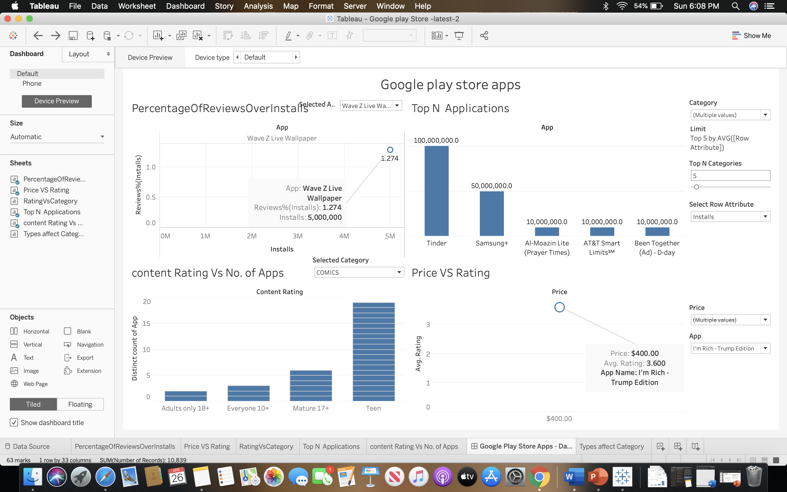
Google Play Store Apps Dashboard
Visualization of final dashboard displaying for 4 visualization for clear visualization of data and high Data-Ink Ratio and Less redundancy. For visualizing more select from left side and drag and drop on the right side in dashboard.
In total we have created 6 different visualization that’s consists of plots like scatter plot, Bar chat, Line chart, Stacked bar chart.

Slide 13
THANK YOU

